Slide 1
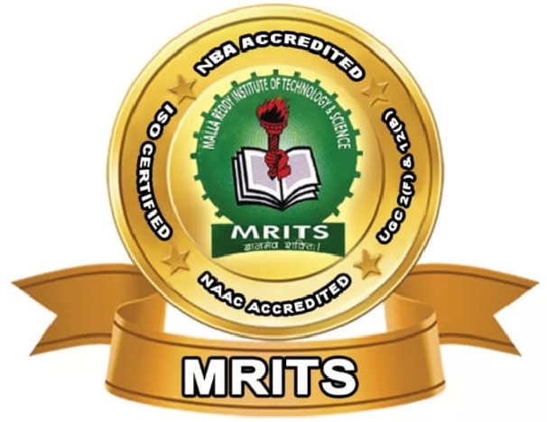
CHATBOT BASED CONTROL INTERFACE FOR HUMAN-ROBOT
PRESENTED BY
K.KEERTHI
18S11D7006
UNDER THE GUIDANCE OF
Dr.S.KANNAN
ASSOCIATE PROFESSOR
DEPARTMENT OF ELECTRONICS AND COMMUNICATION ENGINEERING
MALLA REDDY INSTITUTE OF TECHNOLOGY AND SCIENCE

Slide 2
CONTENTS
Introduction
Block diagram
Algorithms
Requirements
Working
Architecture of chatbot
Applications
Advantages
Future scope
Conclusion

Slide 3
INTRODUCTION
It conducts communication between a human and machine.
To identify the sentence and finding a solution itself to reply.
It intersects with human tools and Environments .

Slide 4
BLOCK DIAGRAM
MICRO-CONTROLLER
DATA BASE
POWER SUPPLY
DRIVER
DC MOTOR
VOICE
MICROPHONE
Notes:
SOLAR

Slide 5
Algorithms
Text classification algorithm
Pattern matching algorithm

Slide 6
TEXT CLASSIFICATION ALGORITHM
Used to answer the queries of the user.
Assignment of natural language texts to predefined categories.

Slide 7
PATTERN MATCHING ALGORITHM
Matching of user’s input with the intent.
Matches the input with the intent of intent word by word and not Category by category.

Slide 8
REQUIREMENTS
Chatting:
Allow the user to chat.
Inform the user if the answer is unavailable and about spelling mistakes.
Searching:
To search about rates , installation and installing companies.
Log:
the system should maintain a log of all the questions and answers.

Slide 9
WORKING
The chatbot will try to understand the question.
It will try to recognize a similar problem in the existing database.
If the answer is sent to the NLP.
If the answer is not available in the data base it will respond with an default answer.

Slide 10
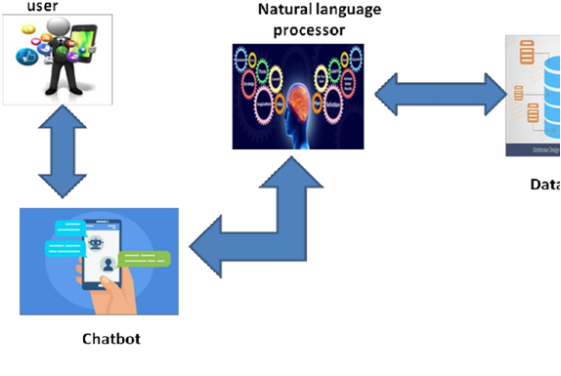
ARCHITECTURE OF CHATBOT

Slide 11
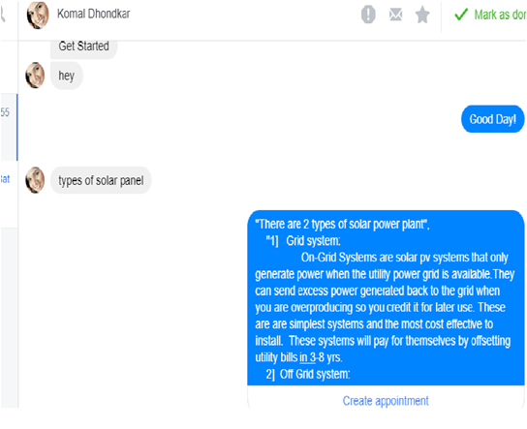
CHATBOT

Slide 12
APPLICATIONS
Medical purposes
Business
Education
Robotics

Slide 13
ADVANTAGES
Low error rate
Accuracy
Speed
Quality

Slide 14
FUTURESCOPE
A mobile application will also be created of this .
A way to reduce human effort at any tasks and ease the work of the user.

Slide 15
CONCLUSION
As use of chatbot saves time and is efficient ,it is attractive for various enterprises , such as e-commerce, retail,banking,leisure,travel,and for companies to increasing their sales.

Slide 16
LITERATURE
SL.NO | Authors | Title of the paper | Remarks
1 | A. Geleukh | Natural Language Processing | Natural language processing is an attempt to bring language processing and its applications into focus to demonstrate techniques that have recently been applied in real world.
2 | S.J. du Preez, M. Lall, S.Sinha | An intelligent web-based voice chatbot. | It presents the design and development of an intelligent voice recognisation chat bot. And it presents a technology demonstration to verify a proposed frame work required to support such a chtbot.
3 | J. P. McIntire, L. K. McIntire, and P. R. Havig | Methods for Chatbot Detection in Distributed Text-Based Communications | A type of chatbot where the primary mode of communication is texting .

Slide 17
CONT’D:
SL.NO | Authors | Title of the paper | Remarks
4 | Pratik Salve, Vishruta Patil, Vyankatesh Gaikwad, Prof. Girish Wadhwa, | College Enquiry Chat Bot | College enquiry chatbot will be built using artificial algorithms that analyzes and effectively answers college related users quarries .
5 | Y. Chen, W. Wang and Z. Liu | Keyword-based search and Exploration on databases | Empowering users to access databases using simple keywords. In this tutorial, we give an overview of the state-of-the-art techniques for supporting keyword-based search and exploration on databases.

Slide 18
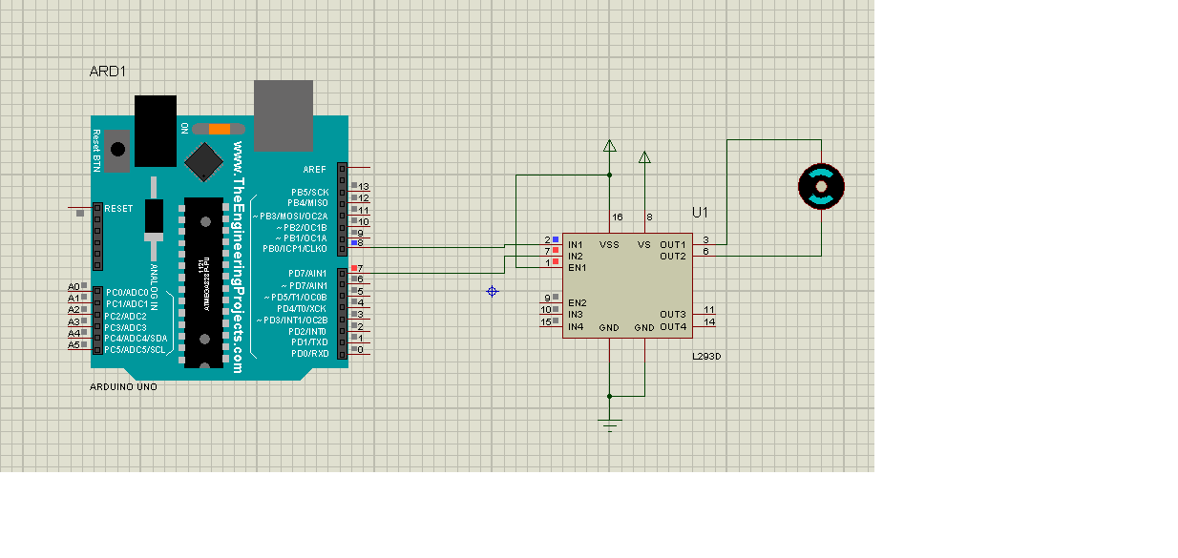
DC MOTOR

Slide 19
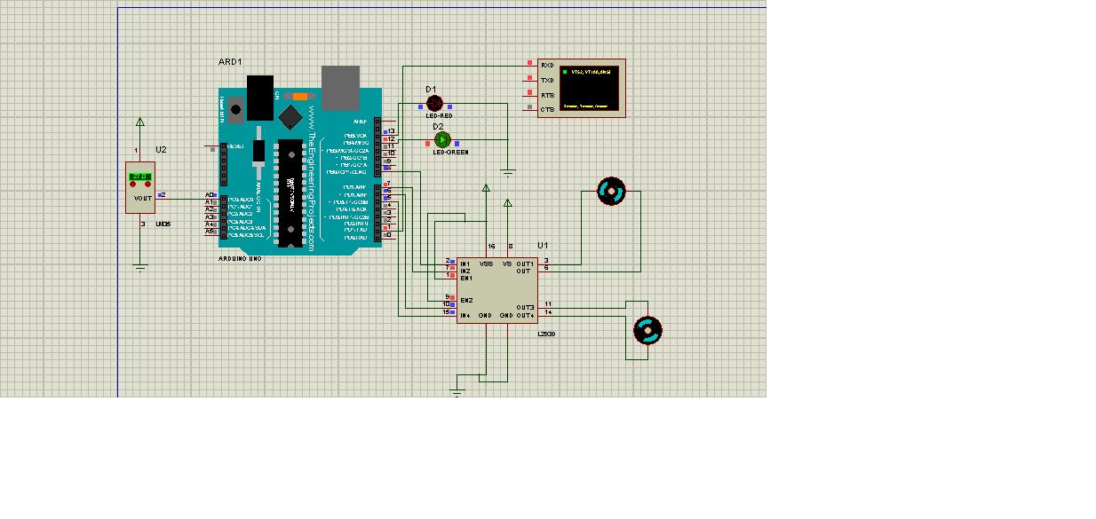
MOTOR WITH LED

Slide 20
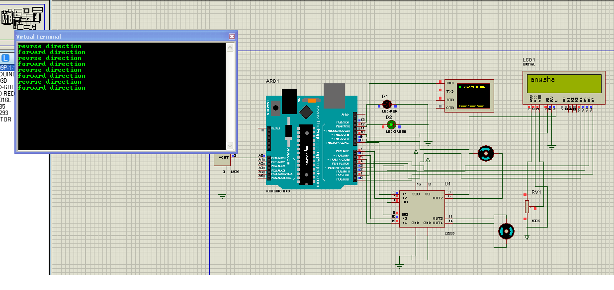
MOTOR WITH LCD

Slide 21
REFERENCES
A. Geleukh, "Natural Language Processing Hybrid Intelligent Systems 2005", HIS '05. 5th International Conference on Hybrid Intelligent Systems (HIS '05), 2005.
Y. Chen, W. Wang and Z. Liu (2011). Keyword-based search and Exploration on databases, 27th International Conference on Data Engineering Hannover IEEE.
S.J. du Preez, M. Lall, S. Sinha, "An intelligent web-based voice chatbot", EUROCON 2009 EUROCON '09 IEEE, 2009.
Pratik Salve, Vishruta Patil, Vyankatesh Gaikwad, Girish Wadhwa, "College Enquiry Chat Bot", International Journal on Recent and Innovation Trends in Computing and Communication, March 2017.
J. P. McIntire, L. K. McIntire, and P. R. Havig, “Methods for Chatbot Detection in Distributed Text-Based Communications,” Proc. IEEE of 2010 International Symposium on Collaborative Technologies and Systems (CTS), 2010, pp. 463-472, doi:10.1109/CTS.2010.5478478.

Slide 22
THANK YOU……..

